Slide 1
MODULE 3
STRUCTURAL TESTING

Slide 2
Structural Testing: Overview, Statement testing, Branch testing, Condition testing, Path testing: DD paths, Test coverage metrics, Basis path testing, guidelines and observations, Data –Flow testing: Definition-Use testing, Slice based testing, Guidelines and observations, Cyclomatic complexity and Examples.

Slide 3
White box or Glass box testing

Slide 4
SOME TERMS
Control Flow Graph
Basic Block or Node
Edge
Adequacy Criterion

Slide 5
TECHNIQUES USED IN STRUCTURAL TESTING
Statement Coverage
Branch Coverage (Decision coverage)
Condition Coverage
Modified Condition / Decision coverage
Path Coverage

Slide 6
TYPES
Control Flow Testing
Data Flow Testing
Slice Based Testing
Mutation Testing

Slide 7
GRAPH REPRESENTATIONS
A directed graph is composed of a set of nodes N and a relation E on the set (that is, a set of ordered pairs), called edges.
It is conventional to draw the nodes as points or shapes and to draw the edges as arrows.
  Nodes: {a,b,c}
  Edges: {(a,b), (a,c), (c,a)}
Nodes represent entities of some kind, such as procedures or classes or regions of source code. The edges represent some relation among the entities.

Slide 8
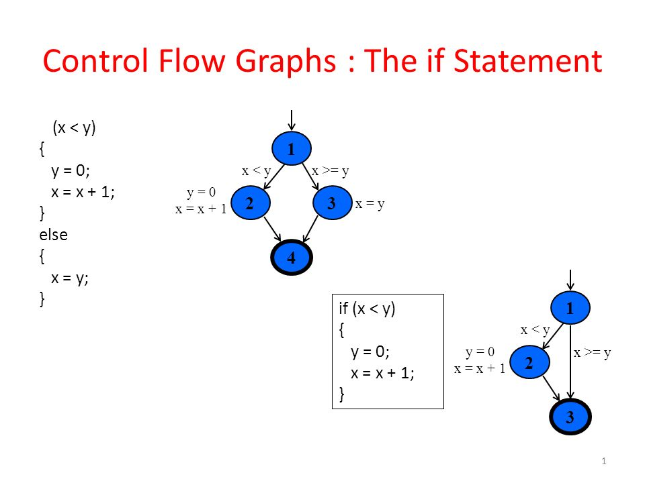

Slide 9
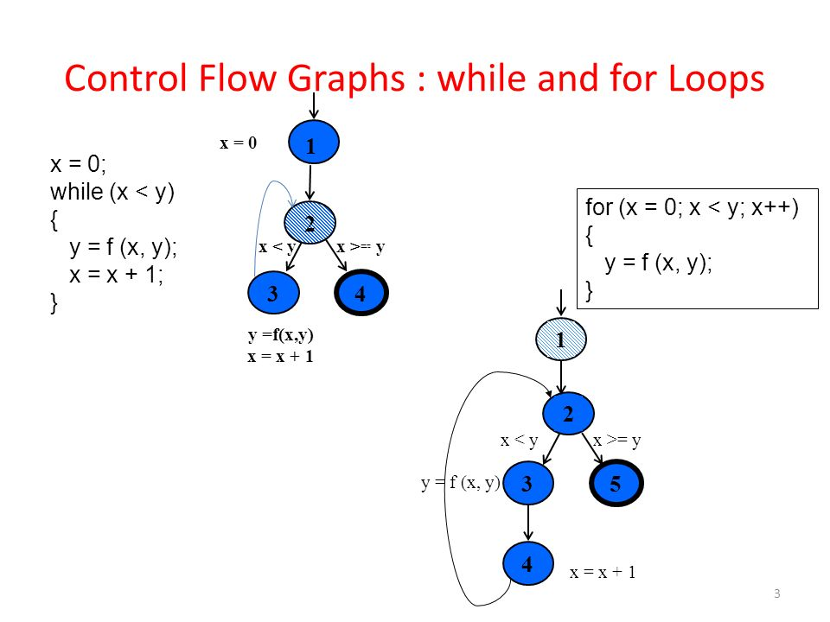

Slide 10
CYCLOMATIC COMPLEXITY
It is a quantitative measure of the number of linearly independent paths in it.
Computed using the Control Flow Graph of the program.
Eg: If source code contains no control flow statement then its cyclomatic complexity will be 1 and source code contains a single path in it. Similarly, if the source code contains one if condition then cyclomatic complexity will be 2 because there will be two paths one for true and the other for false.
Cyclomatic complexity = E- N + 2P

Slide 11
STRUCTURAL TESTING: OVERVIEW
Testing can reveal a fault only when execution of the faulty element causes a failure.
  For example, if there were a fault in a statement of a program, it could be revealed only with test cases which will execute this statement.
Based on this simple observation, a program has not been adequately tested if some of its elements have not been executed.

Slide 12
STRUCTURAL TESTING: OVERVIEW
Control flow testing criteria are defined for particular classes of elements by requiring the execution of all such elements of the program.
Control flow elements include statements, branches, conditions, and paths.
A set of correct program executions in which all control flow elements are exercised does not guarantee the absence of faults.
Execution of a faulty statement may not always result in a failure.
Control flow testing complements functional testing by including cases that may not be identified from specifications alone. A typical case is implementation of a single item of the specification by multiple parts of the program.

Slide 13
STATEMENT TESTING
Most intuitive control flow elements to be exercised are statements, that is, nodes of the control flow graph.
Statement testing is a test strategy in which each statement of a program is executed atleast once.
It is equivalent to finding a path or set of paths through the control flow graph that contains all the nodes of the graph.

Slide 14
STATEMENT COVERAGE
Statement coverage criterion requires each statement to be executed at least once, reflecting the idea that a fault in a statement cannot be revealed without executing the faulty statement.
Let T be a test suite for a program P. T satisfies the statement adequacy criterion for P, iff, for each statement S of P, there exists at least one test case in T that causes the execution of S.
The statement coverage CStatement of T for P is the fraction of statements of program coverage P executed by at least one test case in T.
    CStatement = number of executed statements / number of statements
T satisfies the statement adequacy criterion if CStatement = 1

Slide 15
BRANCH TESTING
A test suite can achieve complete statement coverage without executing all the possible branches in a program
The branch adequacy criterion requires each branch of the program to be executed by at least one test case.
Let T be a test suite for a program P. T satisfies the branch adequacy criterion for P, iff, for each branch B of P, there exists at least one test case in T that causes execution of B.
This is equivalent to stating that every edge in the control flow graph model of program P belongs to some execution path exercised by a test case in T.
The branch coverage CBranch of T for P is the fraction of branches of program P executed by at least one test case in T.
    CBranch = number of executed branches / number of branches

Slide 16
STATEMENTS VS BRANCHES
Traversing all edges of a graph causes all nodes to be visited.
  So test suites that satisfy the branch adequacy criterion for a program P also satisfy the statement adequacy criterion for the same program.
The converse is not true
  A statement-adequate (or node-adequate) test suite adequate) test suite may not be branch-adequate (edge-adequate)

Slide 17
CONDITION TESTING
Goal is to test every condition or test that occurs in the source code. Also called Predicate coverage.
Condition adequacy criterion: each basic condition must be executed at least once.
Each basic condition must have a TRUE and a FALSE outcome at least once during the execution of the test suite.

Slide 18
CONDITION TESTING
A test suite T for a program P covers all basic conditions of P, that is, it satisfies the basic condition adequacy criterion, iff each basic condition in P has a true outcome in at least one test case in T and a false outcome in at least one test case in T.
The basic condition coverage CBasic_Condition of T for P is the fraction of the total number of truth values assumed by the basic conditions of program P during the execution of all test cases in T.
        CBasic_Condition = total number of truth values assumed by all basic conditions / 2 X number of basic conditions
T satisfies the basic condition adequacy criterion if CBasic_Condition = 1

Slide 19
BASIC CONDITIONS VS BRANCHES
Basic condition adequacy criterion can be satisfied without satisfying branch coverage.
Branch and Basic condition are not comparable (neither implies the other)

Slide 20
COVERING BRANCHES AND CONDITIONS
Branch and condition adequacy:
  Cover all conditions and all decisions
Compound condition adequacy:
  Cover all possible evaluations of compound conditions
  Cover all branches of a decision tree

Slide 21
PATH TESTING
Decision and condition adequacy criteria forces us to consider individual program decisions.
Sometimes, a fault is revealed only through exercise of some sequence of decisions (i.e., a particular path through the program).

Slide 22
A test suite T for a program P satisfies the path adequacy criterion iff, for each path p of P, there exists at least one test case in T that causes the execution of p.
This is equivalent to stating that every path in the control flow graph model of program P is exercised by a test case in T.
The path coverage CPath of T for P is the fraction of paths of program P executed by at least one test case in T.
    CPath = number of executed paths / number of paths
The number of paths in a program with loops is unbounded, so this criterion cannot be satisfied

Slide 23
For a program with loops, the denominator in the computation of the path coverage becomes infinite, and thus path coverage is zero no matter how many test cases are executed.
For a feasible criterion: Partition infinite set of paths into a finite number of classes.
Useful criteria can be obtained by limiting
  the number of traversals of loops
  the length of the paths to be traversed
  the dependencies among selected paths

Slide 24
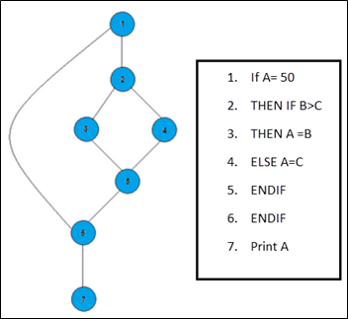
Path 1: 1,2,3,5,6, 7
Path 2: 1,2,4,5,6, 7
Path 3: 1, 6, 7

Slide 25
THANK YOU

